Slide 1

Everything about Data Analytics
DATA ANALYTICS

Slide 2


Contents Points For Discussion :
What Is Data Analytics ?
Data Analytics Feature.
Future Trends In Data Analytics
Top 10 Companies that use Big Data.

Slide 3
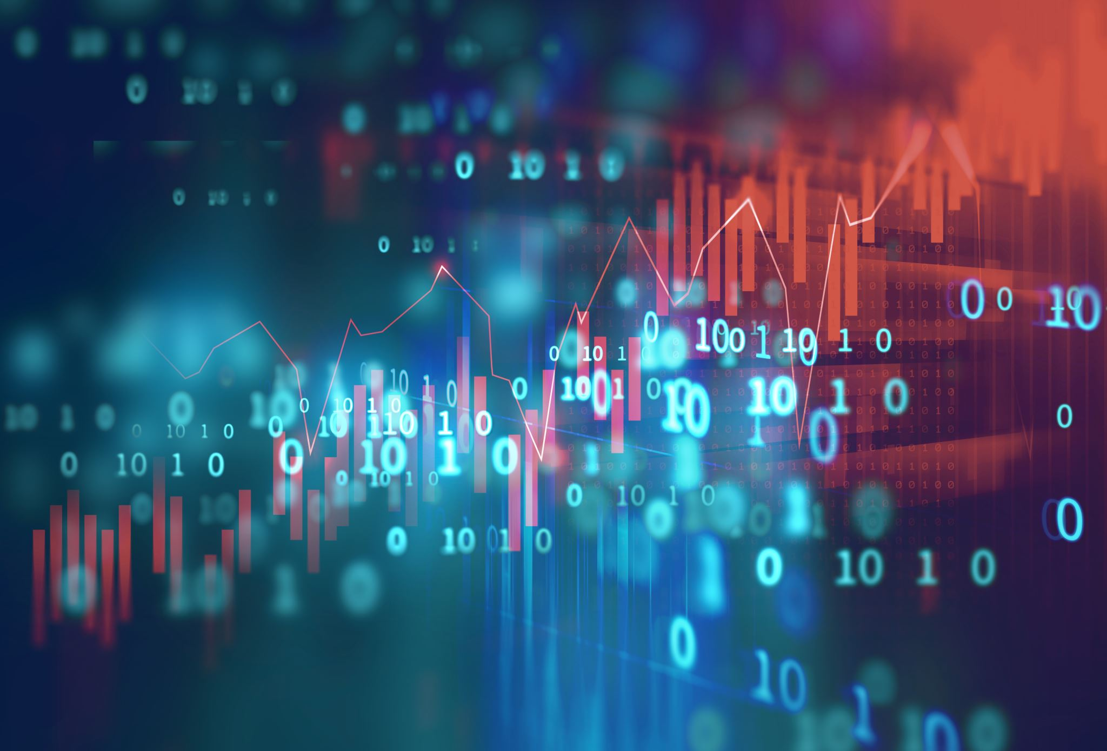
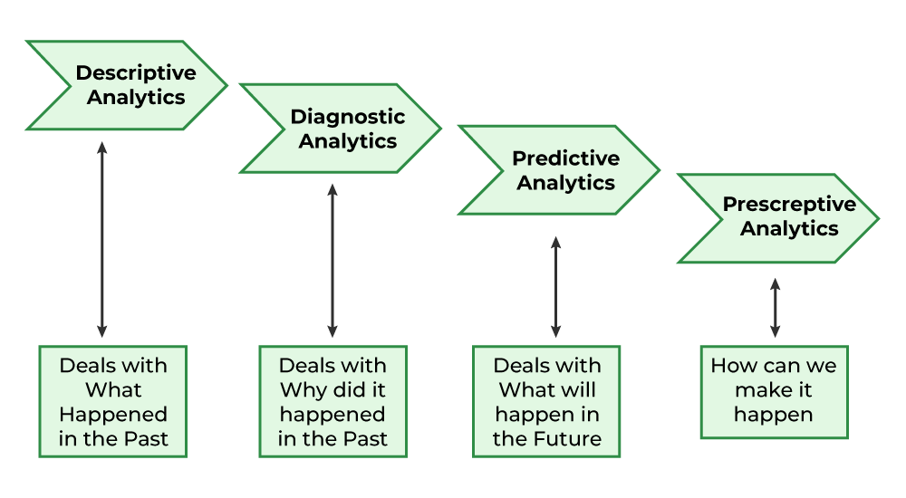
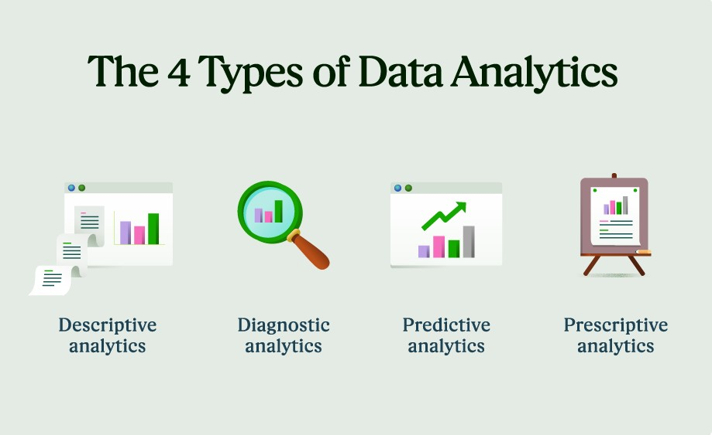
What is data analytics?
Data analytics is the collection, transformation, and organization of data in order to draw conclusions, make predictions, and drive informed decision making.

Slide 4
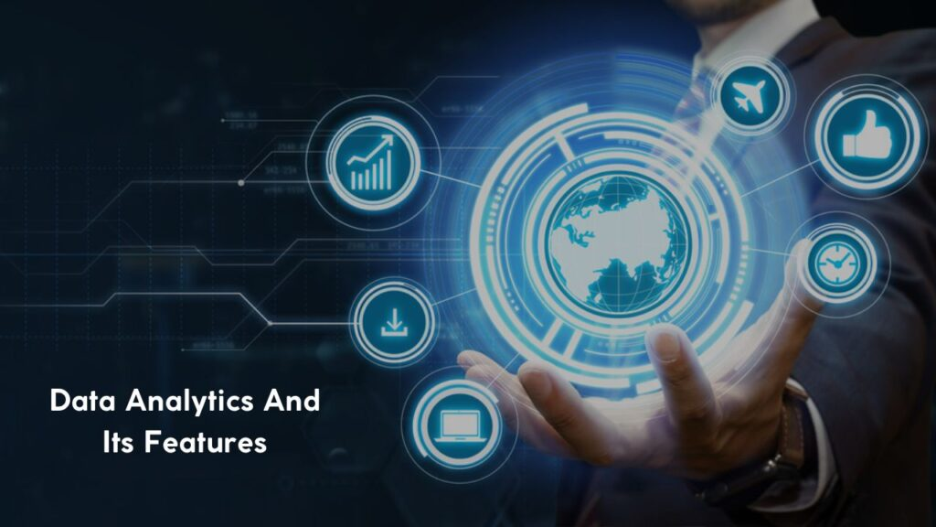
Data analytics is a combination of math and statistics, data collection, data cleaning and processing, data investigation, data analysis, and reporting.

Slide 5
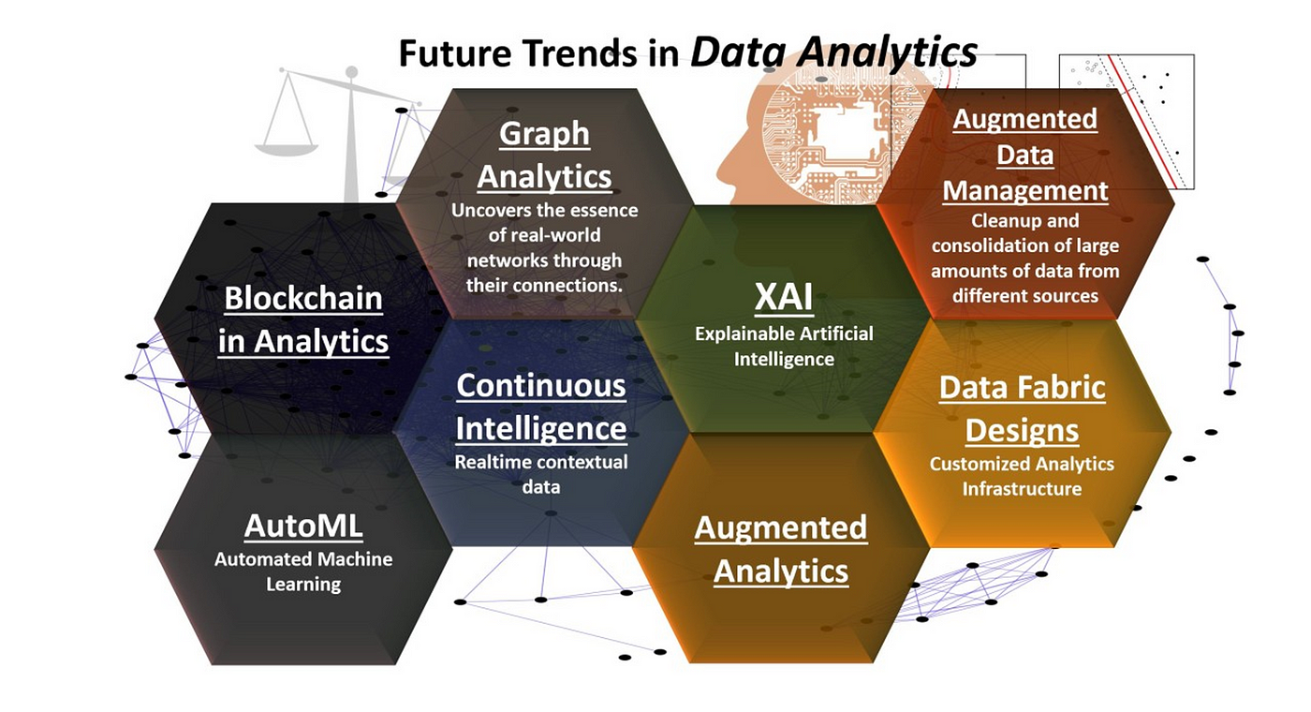

Slide 6
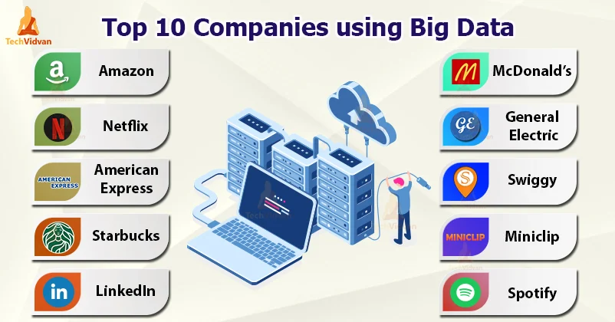
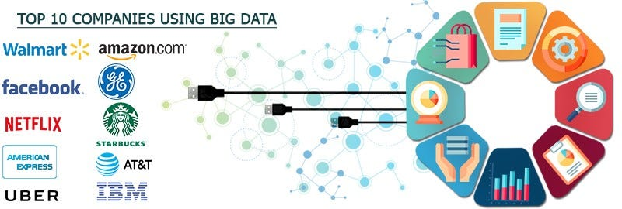

Slide 7
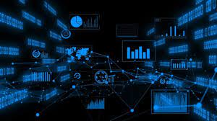

THANK YOU
Thank You

